Slide 1



breakeroperating characteristics analyzer(ACQ) circuit analysis
Translated from Korean to English - www.onlinedoctranslator.com
2021.12.02
Senion Co., Ltd.

Slide 2
index
ACQdevelopment request
ACQBlock Diagram and Circuit Construction
Review the results

Slide 3
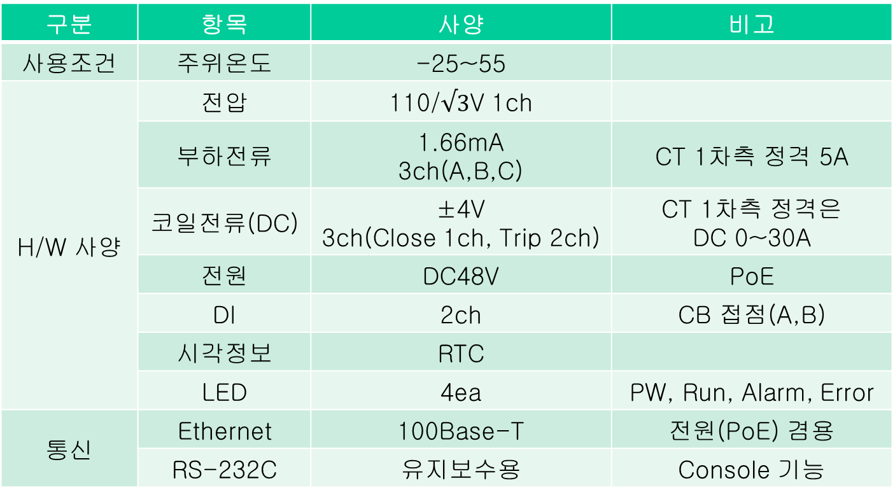
ACQDevelopment request
H/Wspecification
division | item | specification | note
conditions of use | ambient temperature | -25 to 55
H/W specification | Voltage | 110/$√3$V 1ch
 | load current | 1.66mA 3ch(A,B,C) | CTOneSecondary side rating5A
 | coil current(DC) | ±4V 3ch(Close1ch, Trip 2ch) | CTOneSecondary side rating DC 0~30A
 | everyone | DC48V | PoE
 | DI | 2ch | CBContact(A, B)
 | visual information | RTC
 | LED | 4ea | PW, Run, Alarm, Error
communication | Ethernet | 100Base-T | everyone(PoE)Combined use
 | RS-232C | for maintenance | Consolefunction

Slide 4
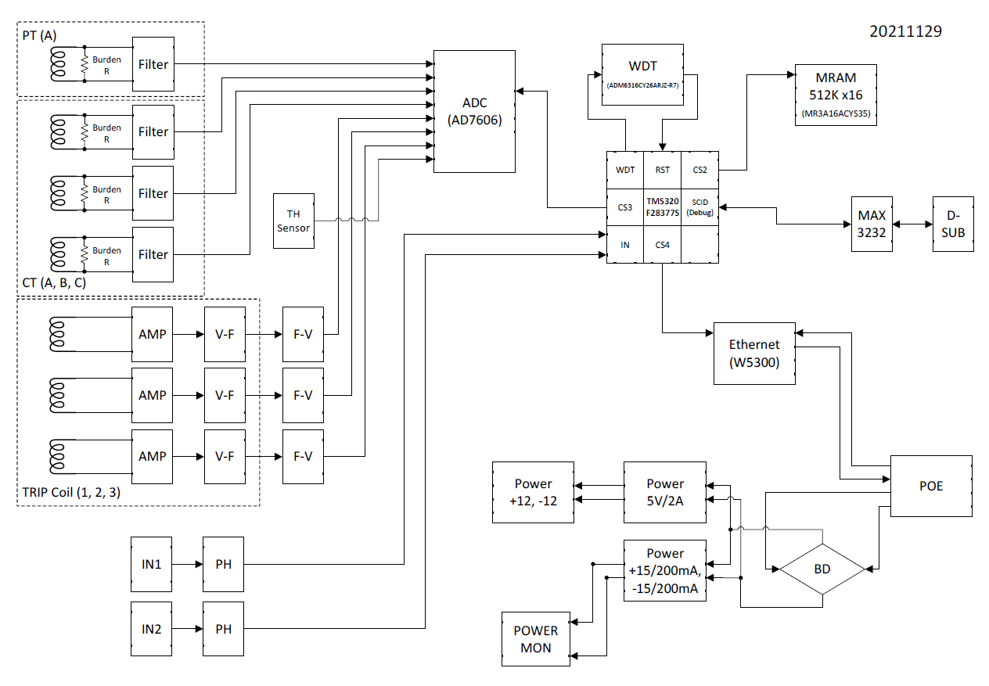
ACQblock diagram
OutWatchdog
non-volatileMemory
PT 1ch
16bit ADC
load current 3ch
temperature Senser
for maintenance
coil current 3ch
C28line
DSPprocessor
power andEthernet
CBContact2ch

Slide 5
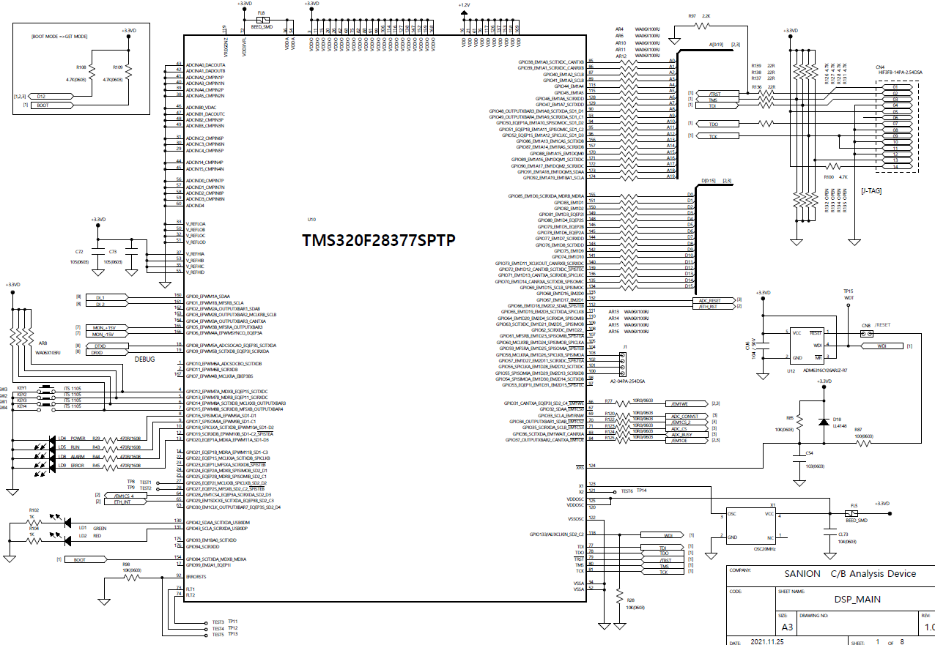
ACQcircuit configuration(MAIN)
Wiznet, MRAM
address pin
DI 2ch GPIO
Wiznet, MRAM,ADC
data pin
C28line
DSP Coreprocessor
200Mhz
ADC,MRAM
control pin
Reset time out140ms
Watchdog time out 1.6s
LED 4ea
JTAG

Slide 6
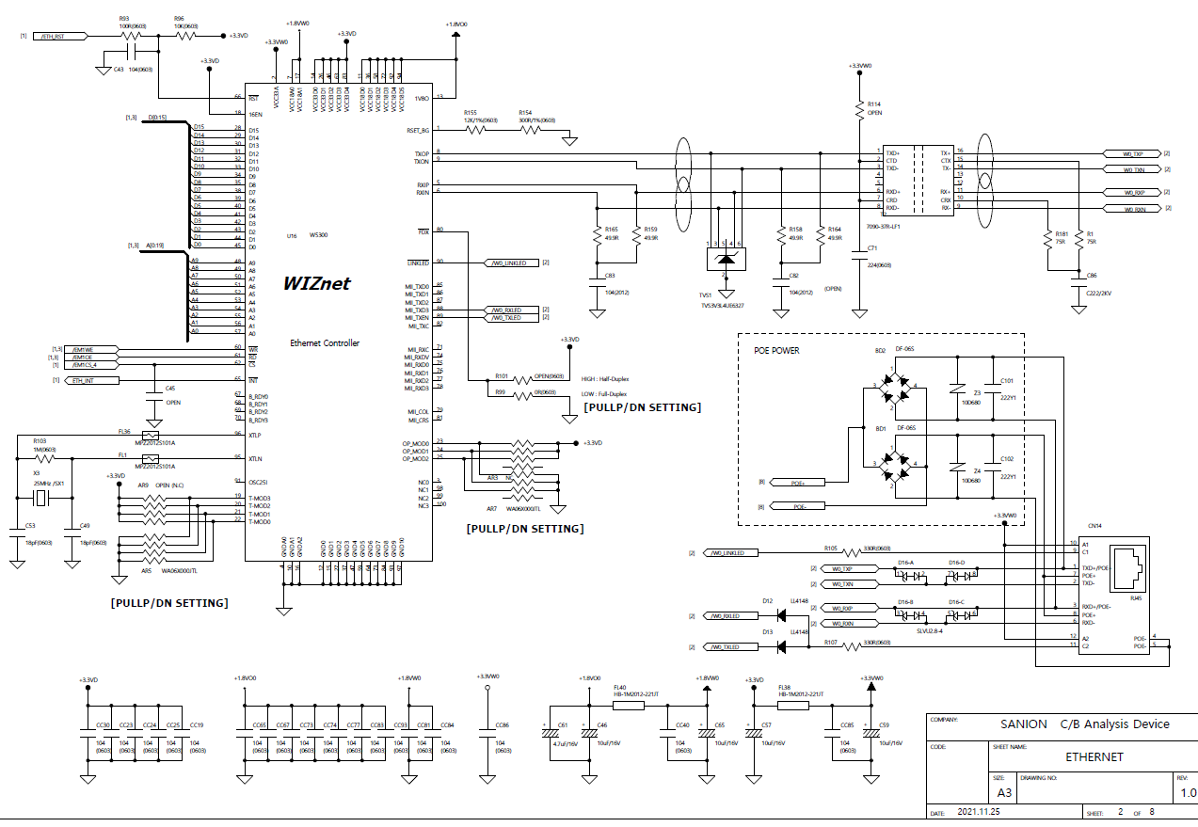
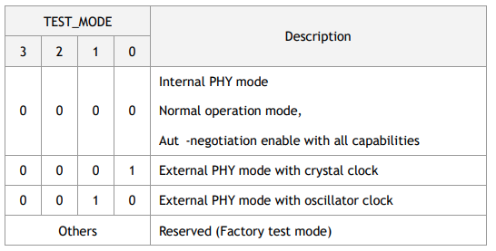
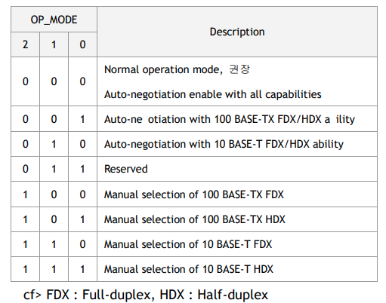
Ethernet(WiznetW5300)
Linksignal
DSP GPIOallocation required
SAFARI EMCCountermeasures
nCS4area
Need to inquire what intention it was designed for
PoE Circuit
RJ45pin
1:TXD+2:TXD-
3: RXD+6:RXD-
4,5:PoE+ 7,8:PoE-

Slide 7
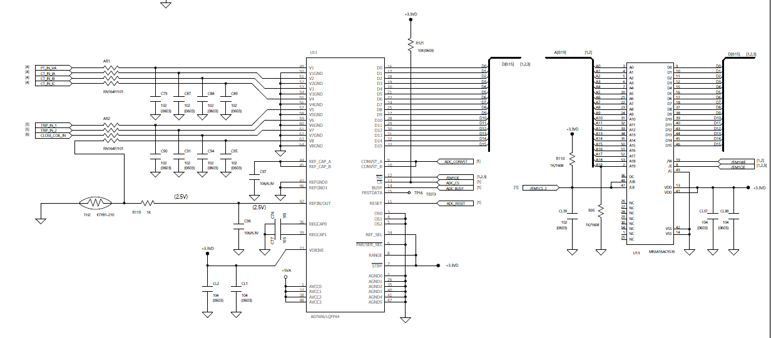
ADC & MRAM
RC LPF
ADC if it affects the inputCAPeliminate…
nCS3 ADCarea
nCS2 MRAMarea
8Chinput
16bit Data
temperature Senser

Slide 8
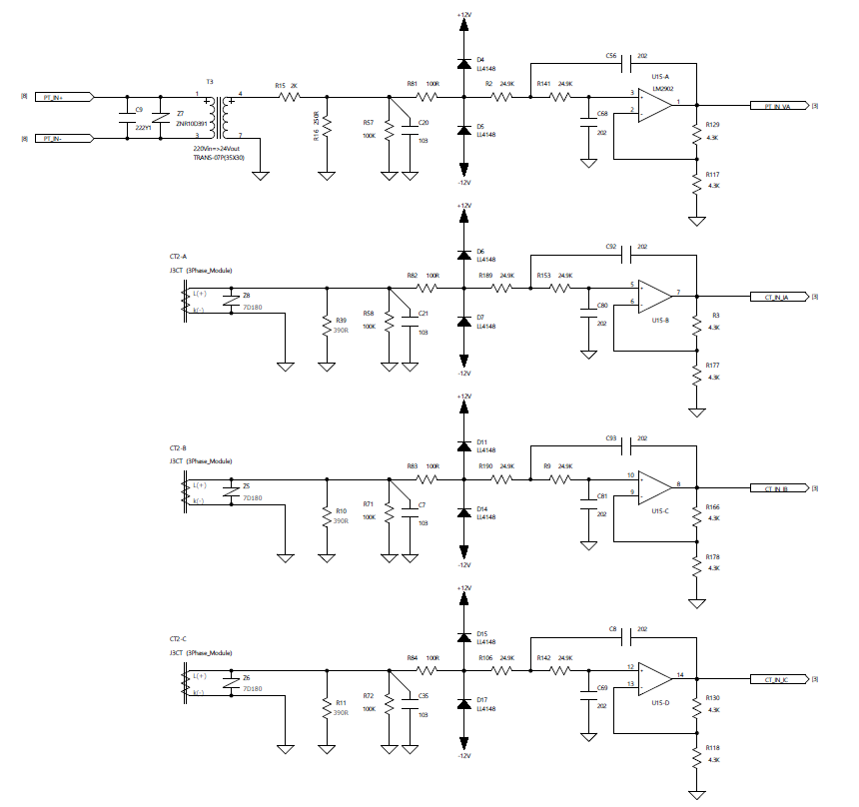
PT&Load current measurement
Sallen-KeyLPF
Fc = 3.195 kHz
PT 1ch
ADCinput
load current3ch

Slide 9
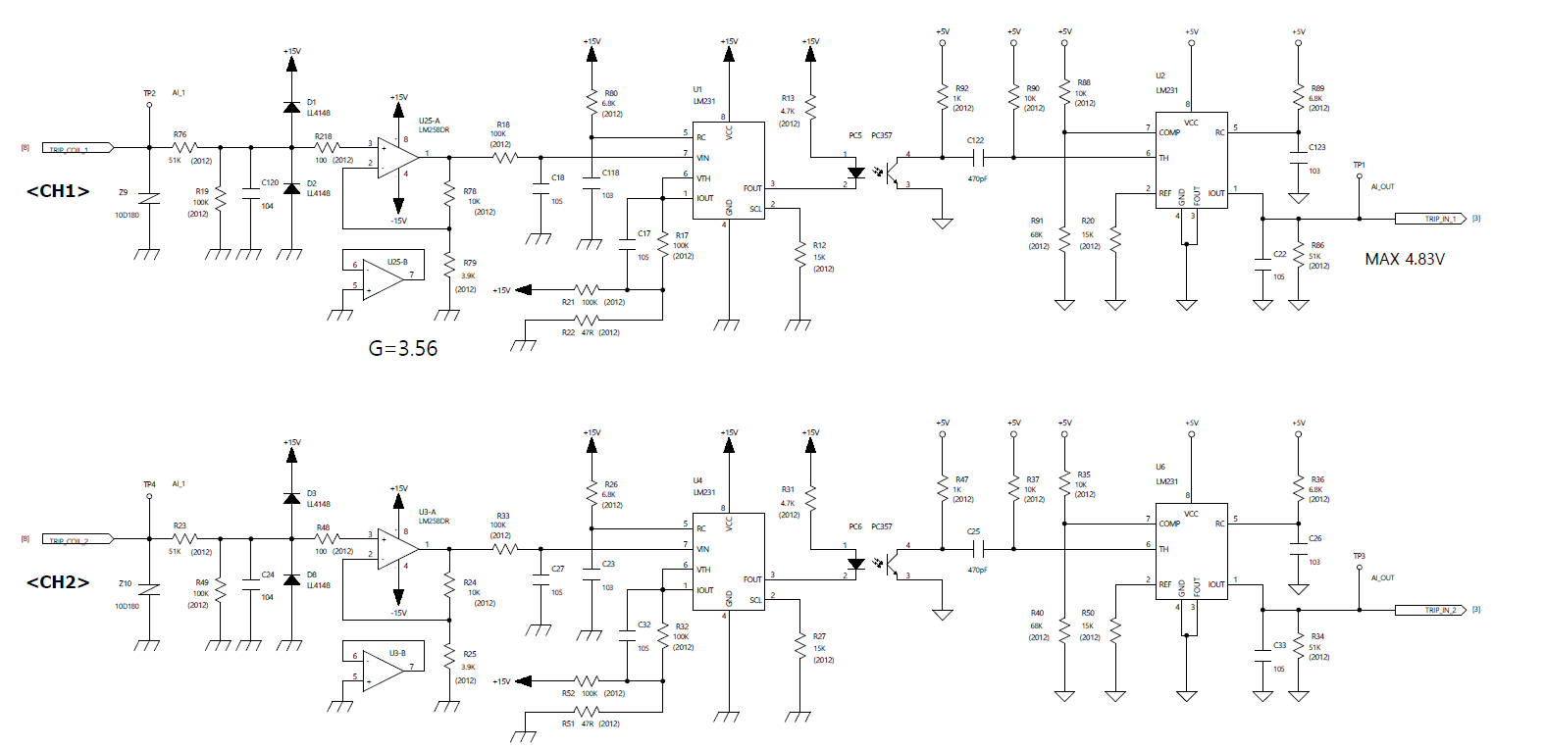
coil current
Voltageto Frequency
Frequency to Voltage
VD=0.66
Gain = 3.56

Slide 10
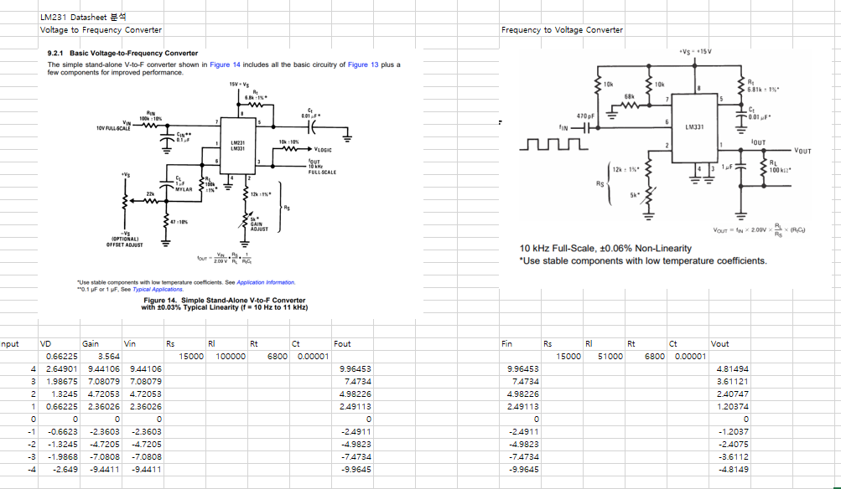

Slide 11
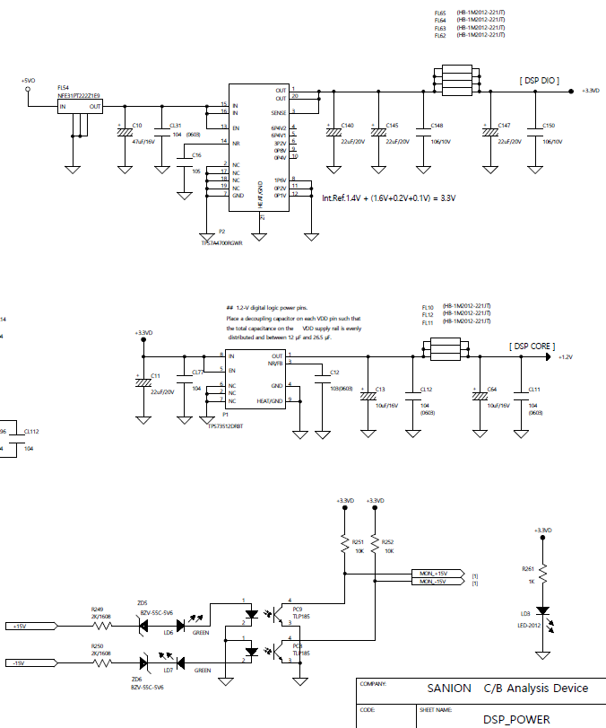
power circuit

Slide 12
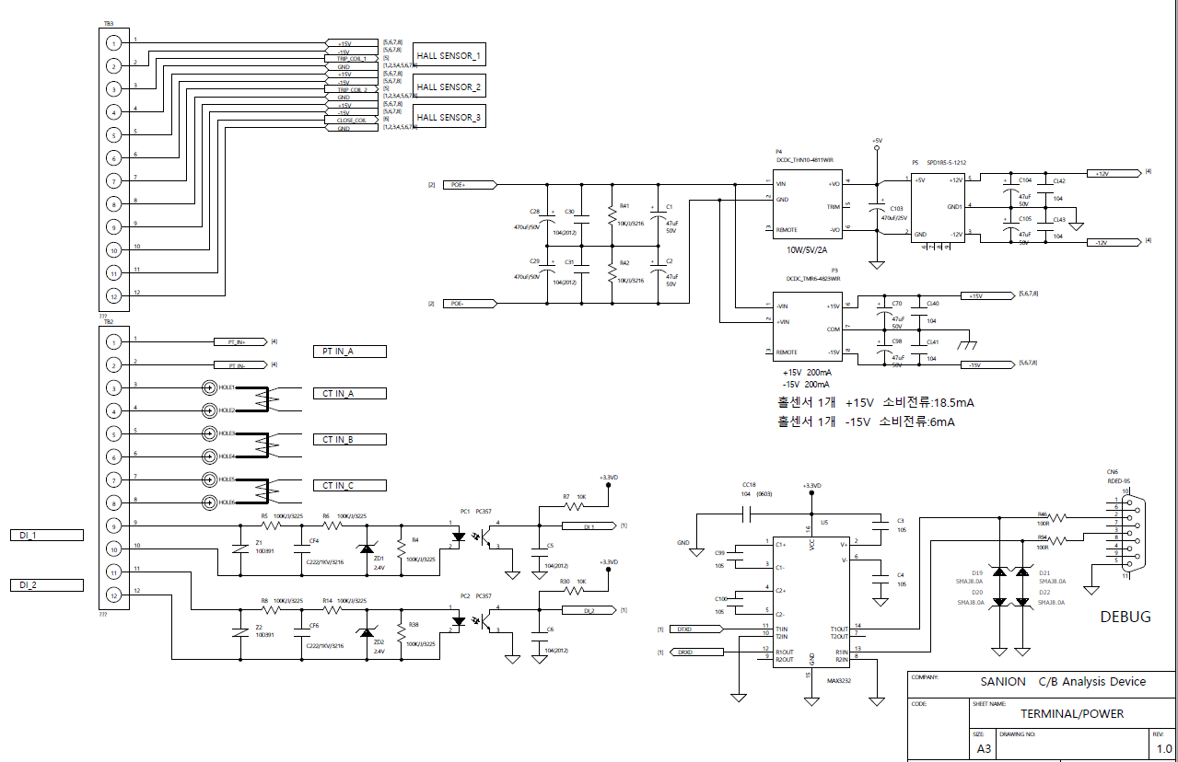
I/O andD-SUB
load current
for measurement everyone
coil current 3ch
4pinEach connector needs to be disconnected
coil current for measurementeveryone
PT 1ch
load current 3ch
for maintenance
IEDsWiring power from outsideI have to.
RTUin a wayModification required

Slide 13
Review the results
Review of development requests
For power and input/output specifications,confirmed
DIcontact circuitModification required
Separation required for coil current input terminal
RTCno.
Thomas Inquiries
PoE in the power circuitaboutProceed with inquiry
external memoryIsare you not using Need to be confirmed

